Slide 1
Material gate pass mockups

Slide 2
Dashboard

Slide 3
Add Request

Slide 4
Create Pass (Visitor)

Slide 5
Create Pass (Material)
PO Number (Yes) ________ (No)
Details (section)

Slide 6
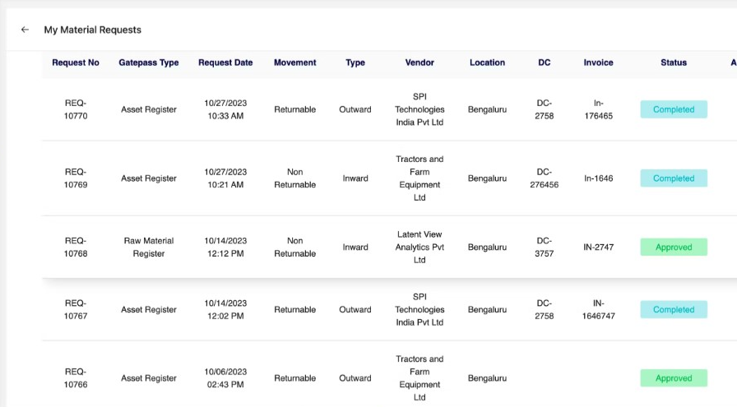
View Request

Slide 7
View Pass
Filters: Returnable / Non Returnable / Any
Filters: Inward / Outward

Slide 8
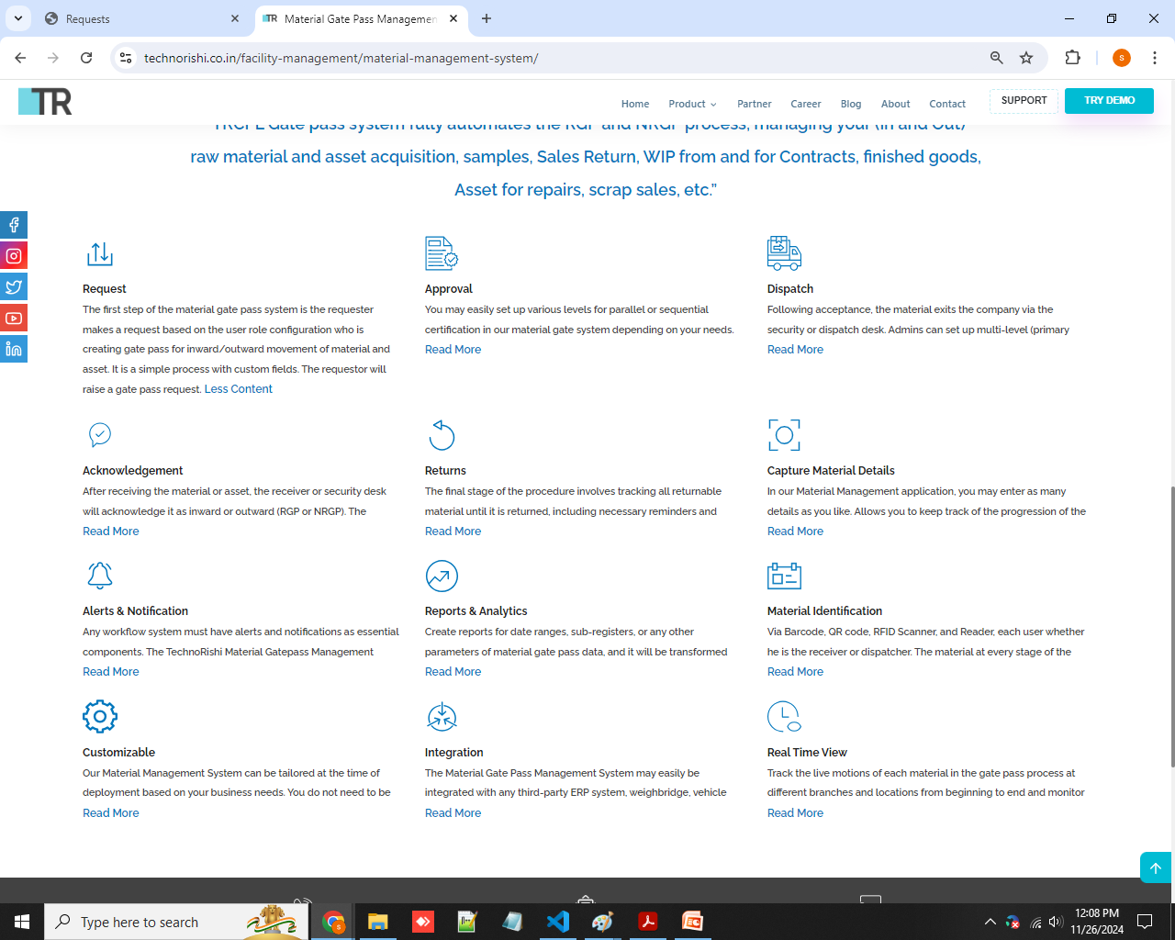
https://youtu.be/lq1ouqXtXgE

Slide 9
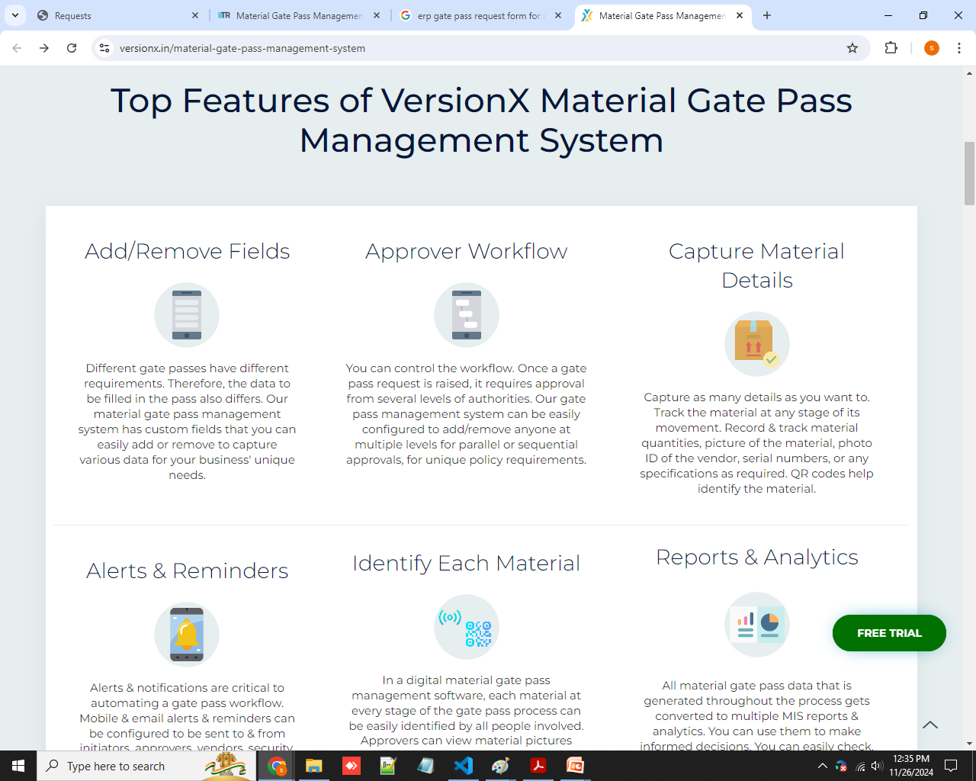

Slide 10
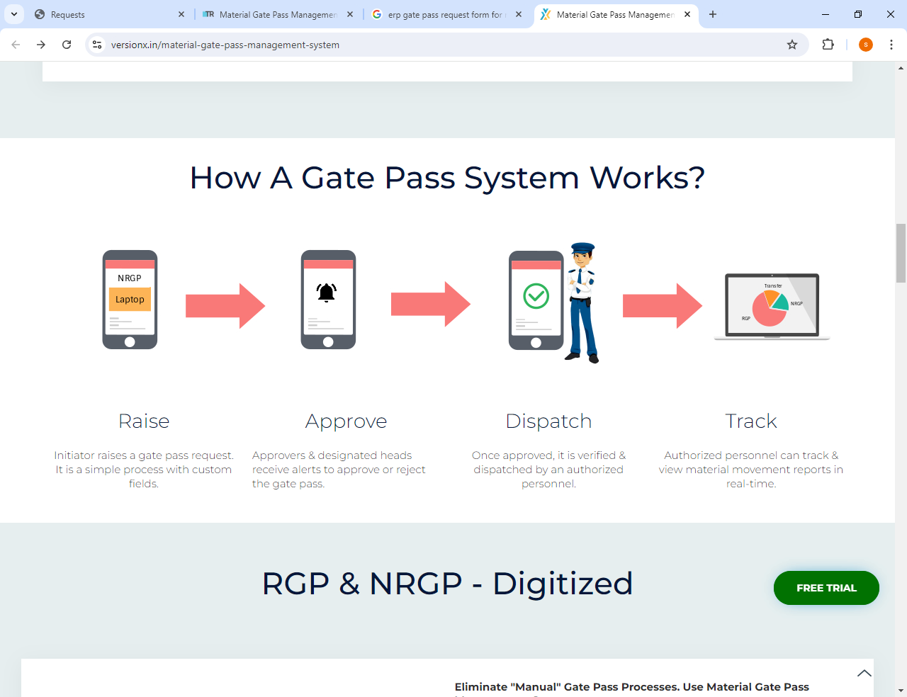

Slide 11
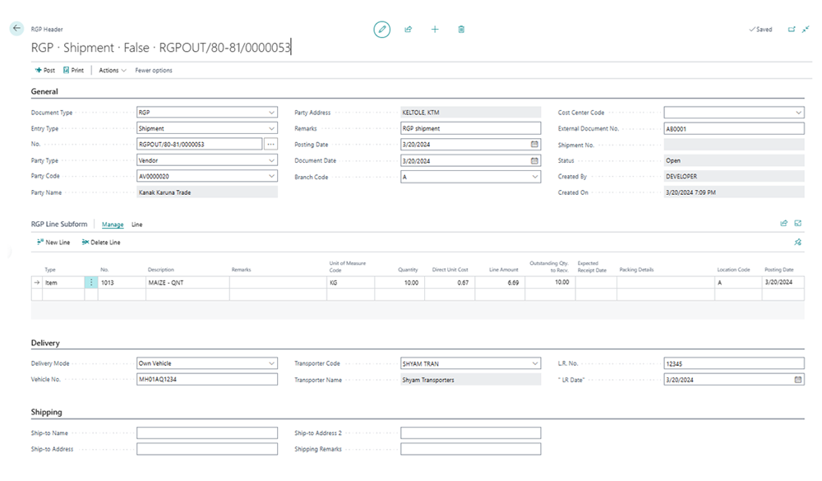

Slide 12
